Slide 1
Excitation Tables
J | K | Qt+1
0 | 0 | Qt
0 | 1 | 0
1 | 0 | 1
1 | 1 | Qt’
T | Qt+1
0 | Qt
1 | Qt’

Slide 2
D | Qt+1
0 | 0
1 | 1
S | R | Qt+1
0 | 0 | Qt
0 | 1 | 0
1 | 0 | 1
1 | 1 | ?
(d) SR FF

Slide 3
DESIGN PROCEDURE
The problem may be given by the word description or state diagram or state table
From the given information obtain the state table
Reduce the number of states if necessary.
Assign binary values to the states.
Determine the number of FFs needed and assign a letter symbol to each
Choose the type of flip-flops to be used.
Derive the circuit excitation and output tables
Derive the simplified flip-flop input equations and output equations.
Draw the logic diagram.

Slide 4
Example 1: Design the synchronous sequential circuit for the following state diagram using JK FF
Solution:

Slide 5
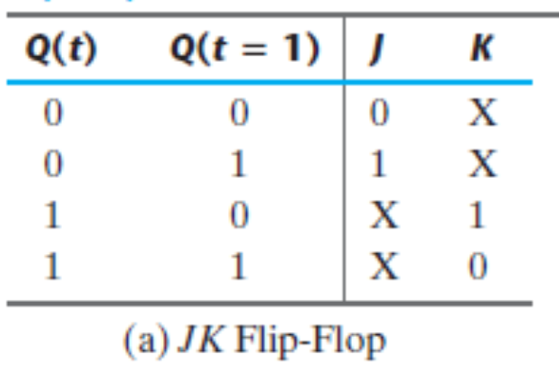

Slide 8
Example 2: Design the synchronous sequential circuit for the following state diagram using T FF-(Exercise for the students to solve)
Solution:
Ta = A’B +Bx’
Tb = B’x’ + Ax’ + A’Bx

Slide 9
Design with D FFs
Design if
A(t+1)=
B(t+1)=
Solution:

Slide 12
Design the synchronous sequential circuit for the following state table:

Slide 13
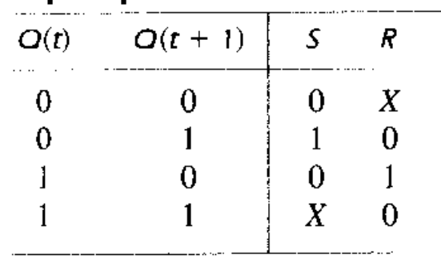

Slide 14
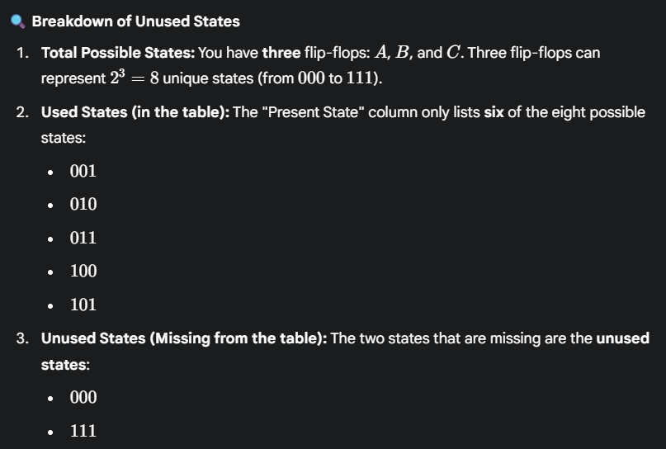

Slide 15
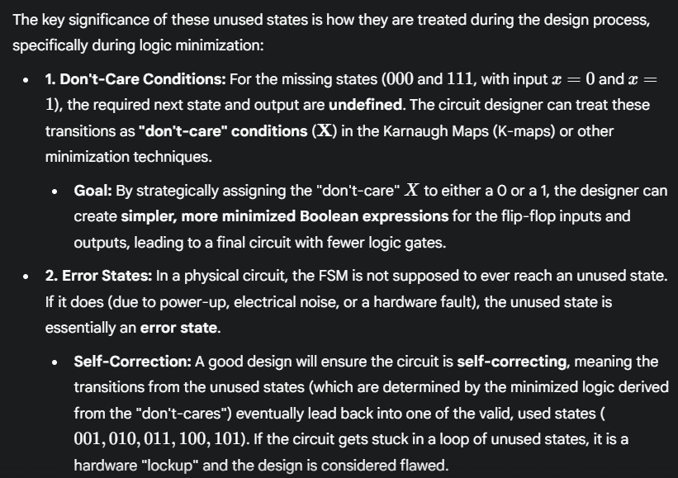

Slide 16





Here 111 and 000 were unused so we put X wherever they appeared in SA

Slide 18
Example: Design a sequential circuit with two JK flip-flops A and B and two inputs E and F . If E = 0, the circuit remains in the same state regardless of the value of F . When E = 1 and F = 1, the circuit goes through the state transitions from 00 to 01, to 10, to 11, back to 00, and repeats.
When E = 1 and F = 0, the circuit goes through the state transitions from 00 to 11, to 10, to 01, back to 00, and repeats
Solution:
JA = KA = (B’F’ + BF)E
JB = KB = E

Slide 19
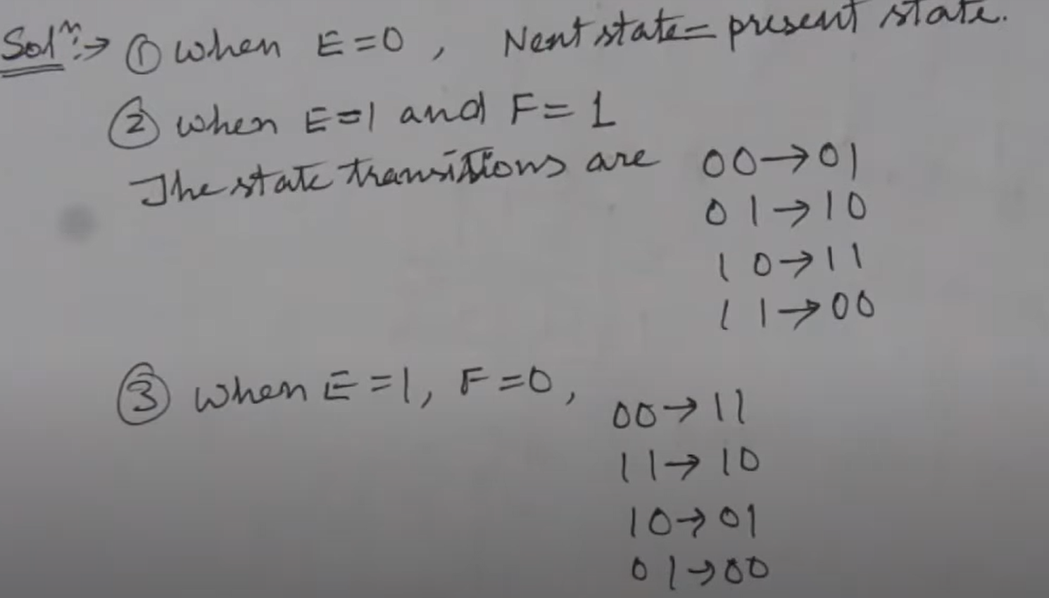

Slide 20
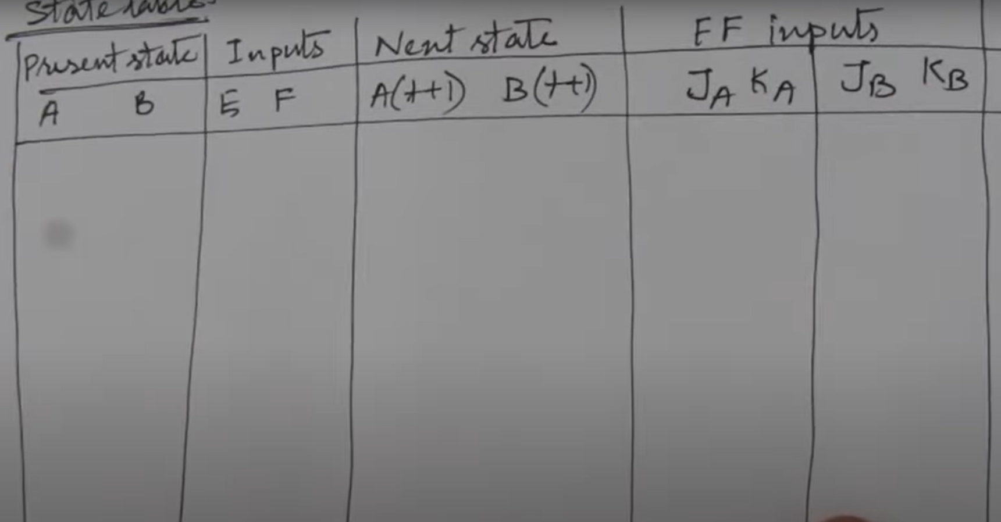

Slide 21
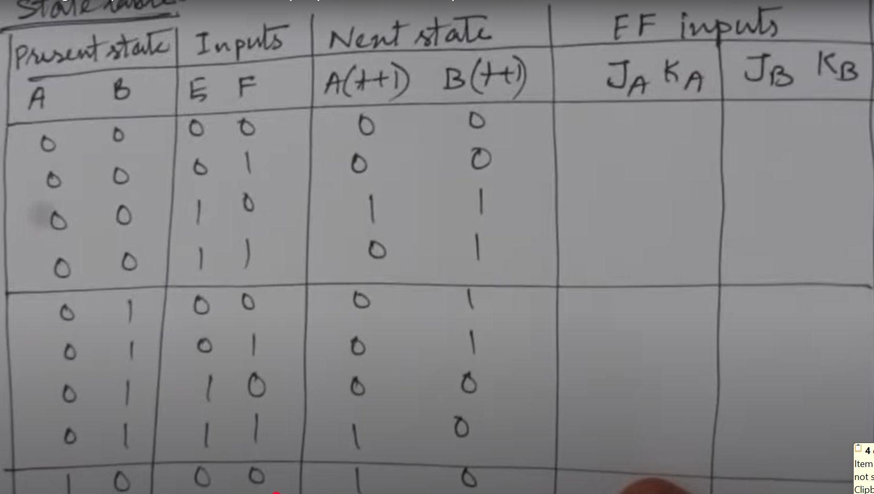

Slide 22


Slide 23
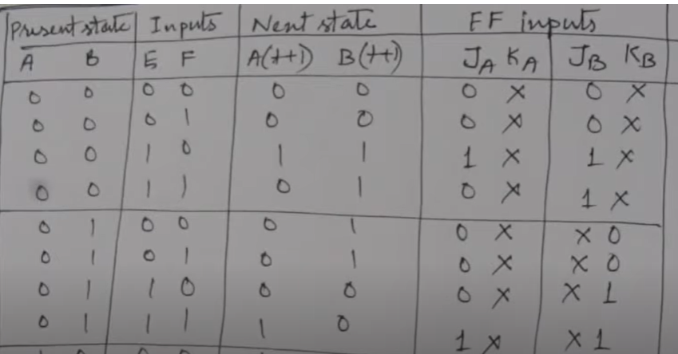


Slide 24
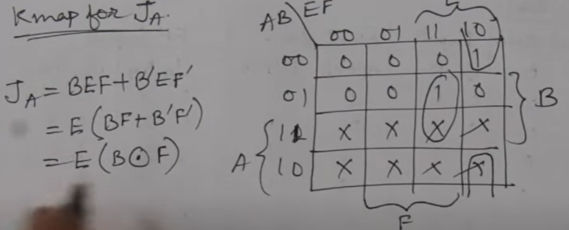
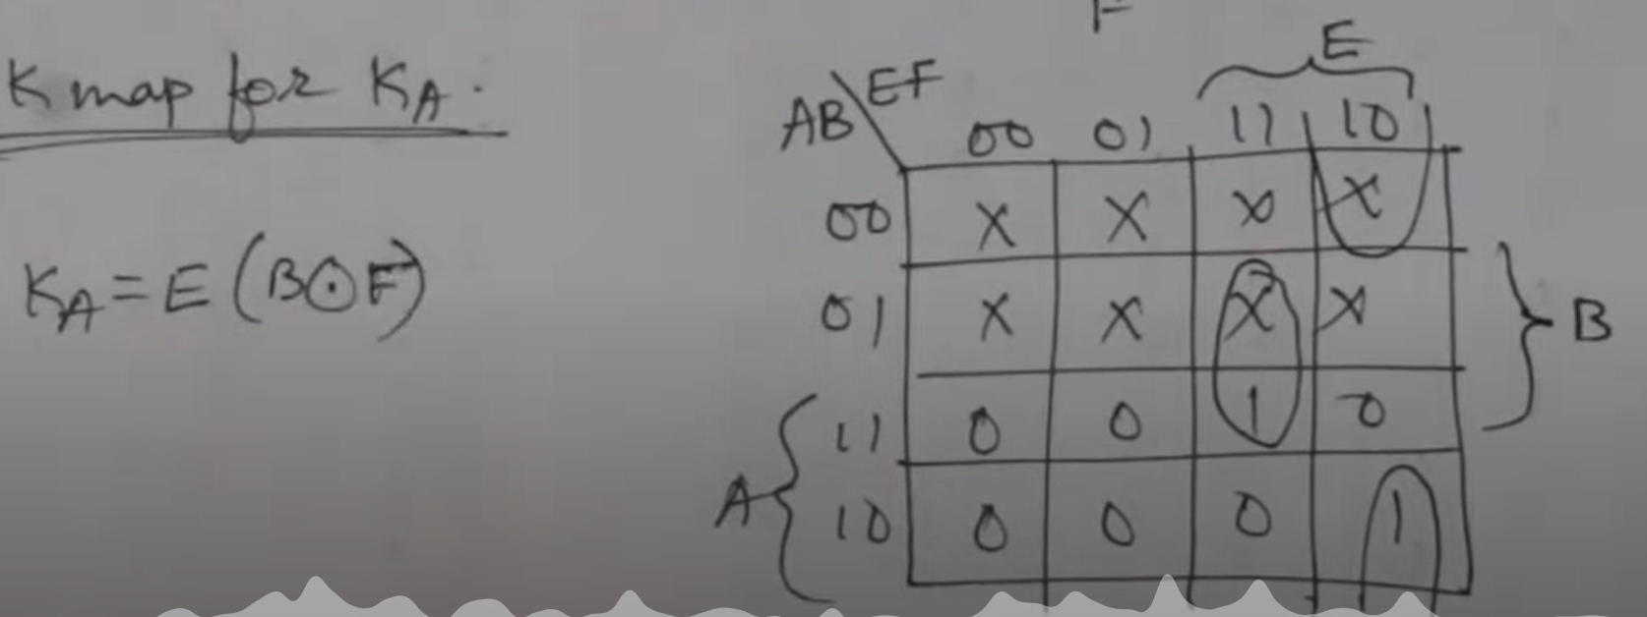

Slide 25
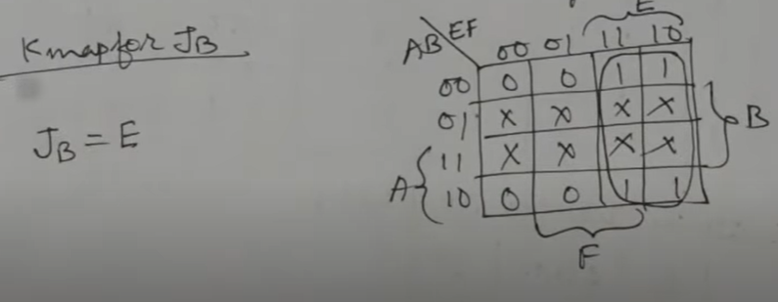
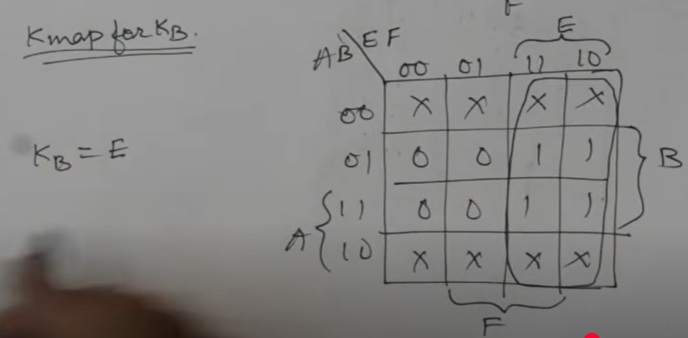

Slide 26
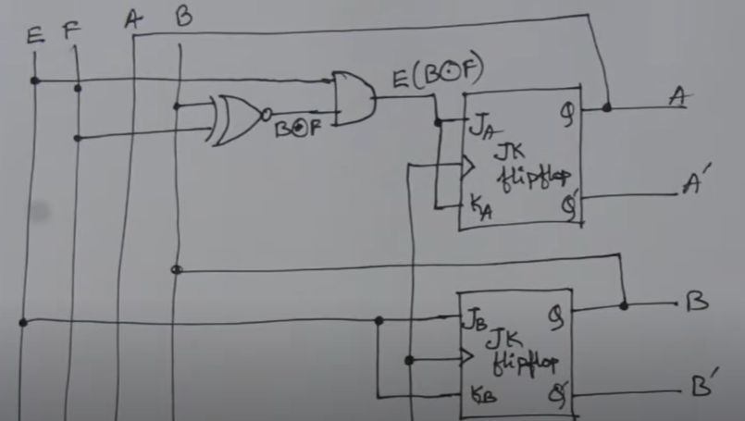

Slide 27
2
Design a sequential ckt with D flip flops , A and B and one input x. when x=0, the state of the ckt remains same . When x=1 the ckt goes through the state transitions from 00 to 01 to 10 to 11 to 00 and repeats. (updated problem)
3. Design the sequential circuit for the following state diagram

Slide 28
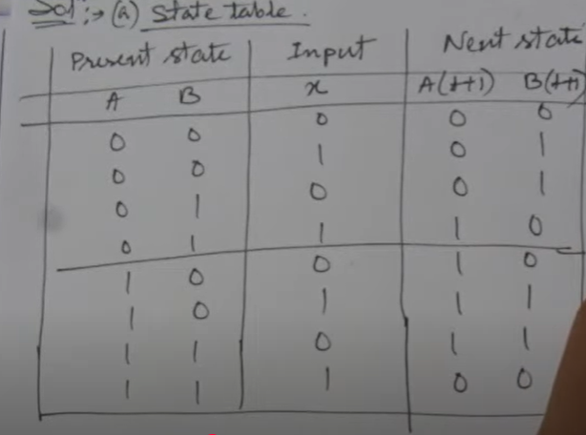
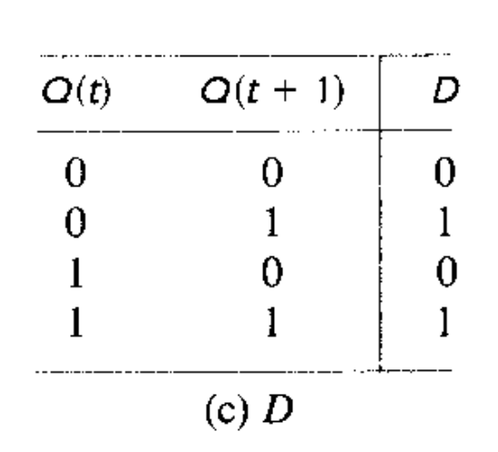
Solution for prblm 2.

Slide 29
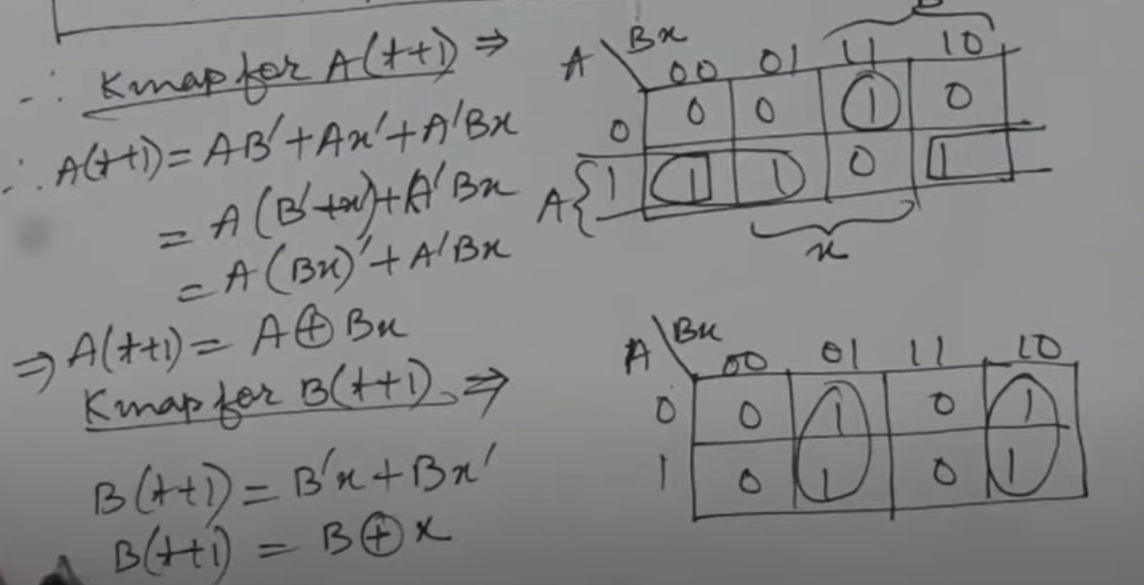

Slide 30
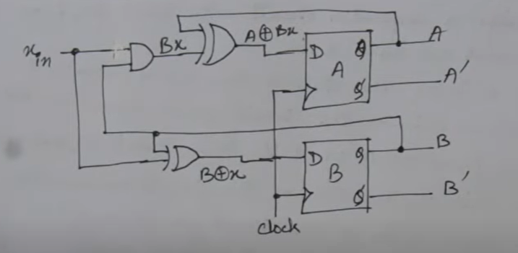

Slide 31
Problem 3 solution :: student should try

Slide 32
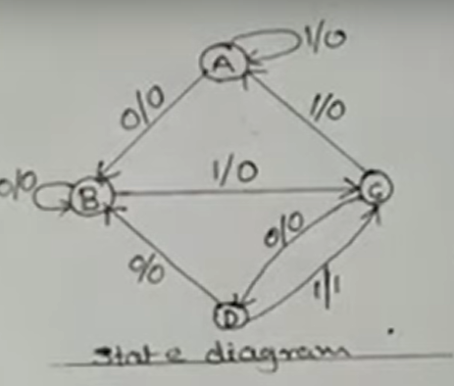
Problem 4. Design a sequential ckt for the given state diagram using D FF’s

Slide 33
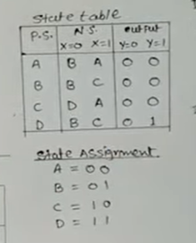
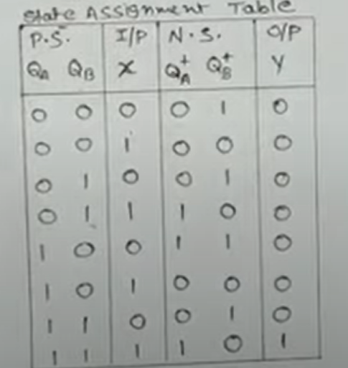
Problem 4. solution

Slide 34
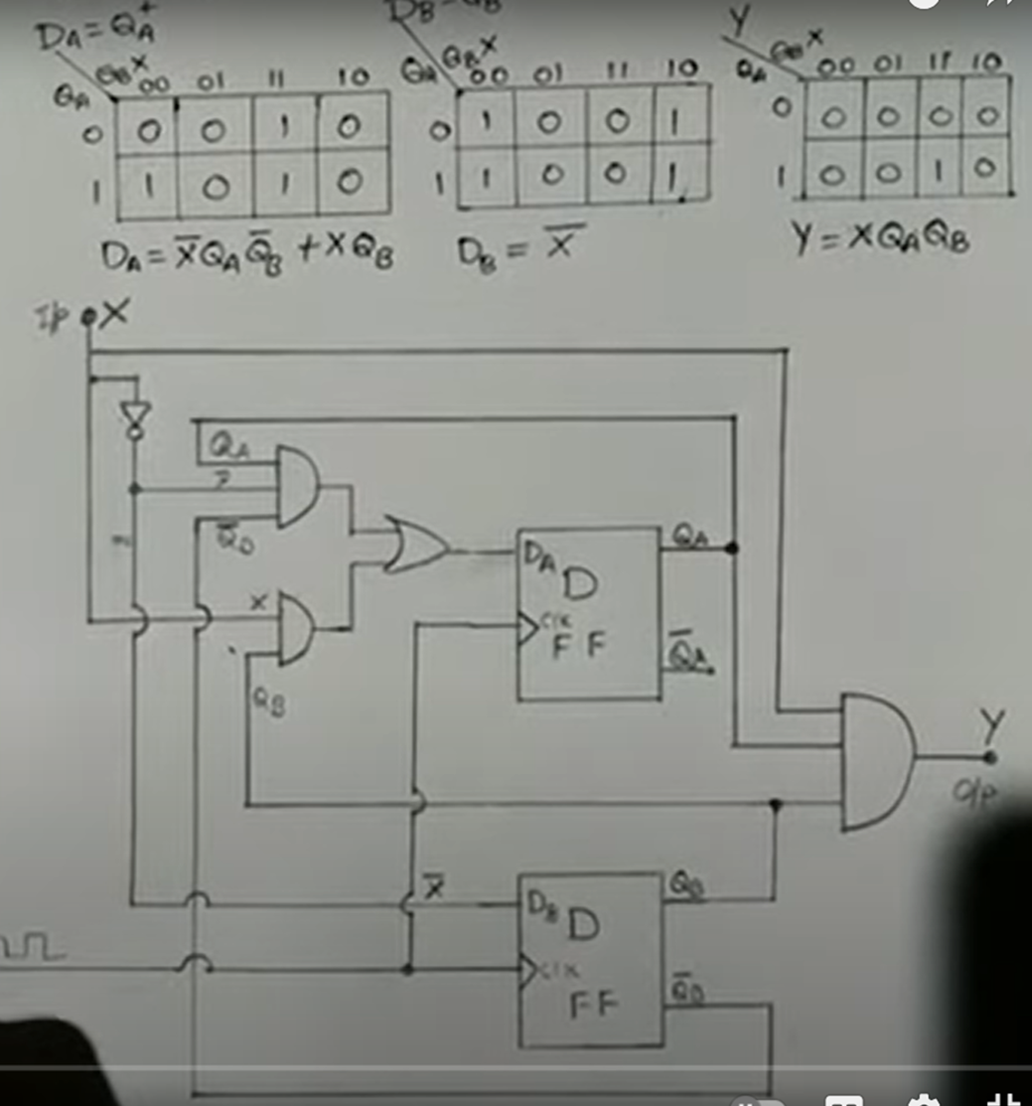
Problem 4. solution

